Slide 1
AV Platform Roadmap
July 2021

Slide 2
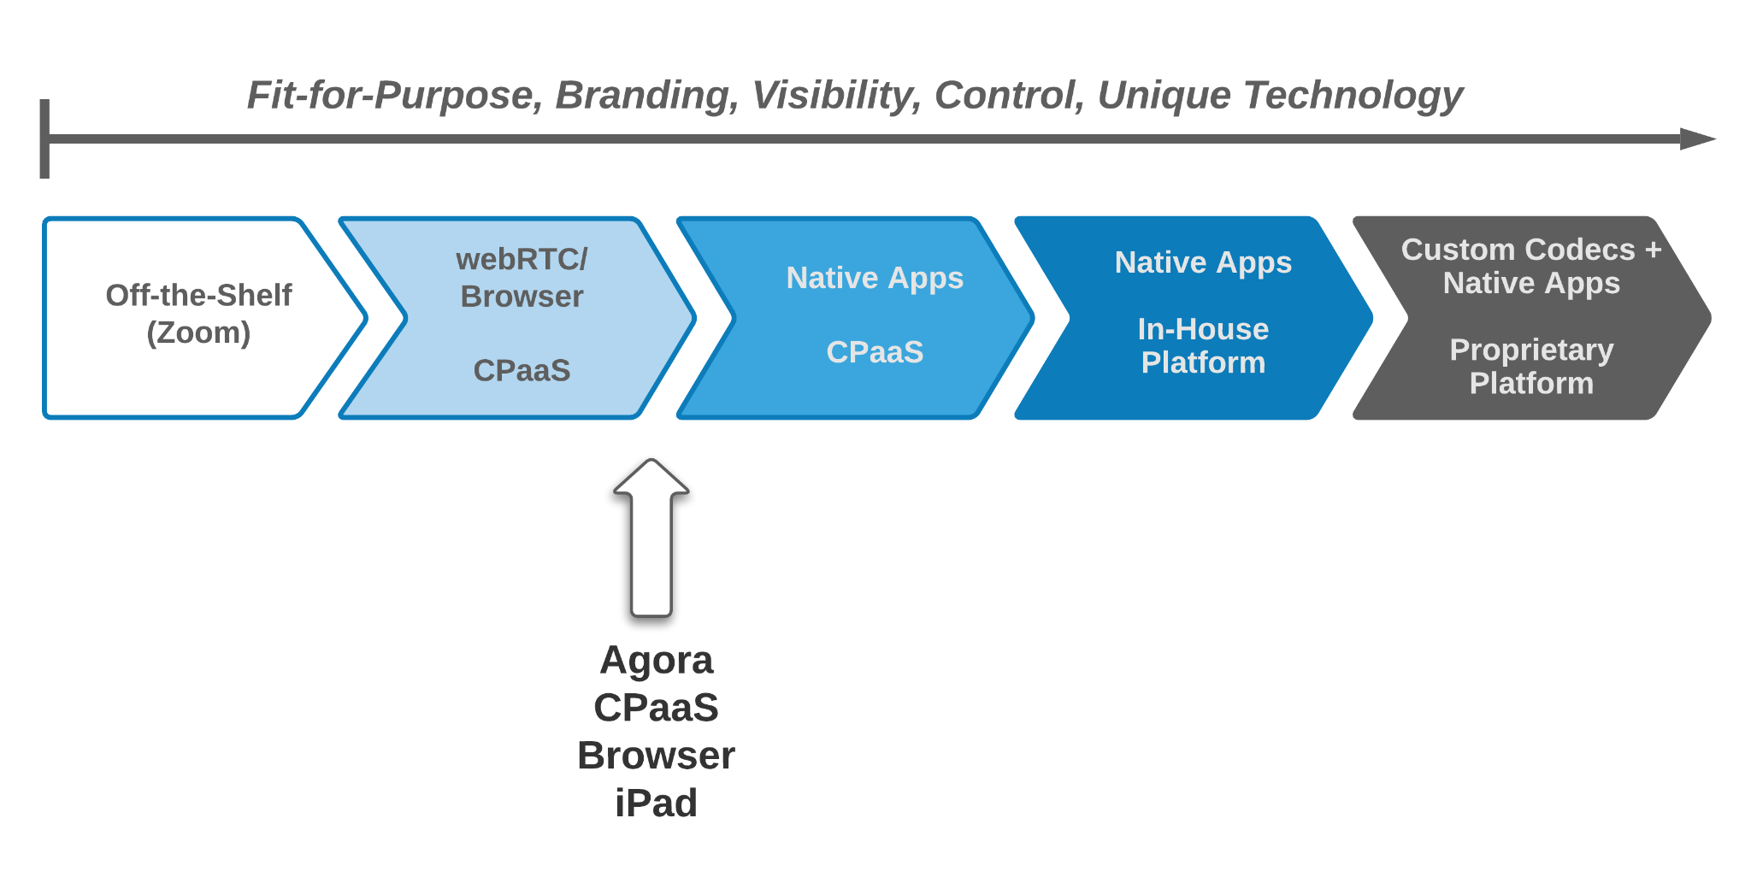
AV Roadmap
Current State
iPad app is a step toward native apps, but motivation is mostly platform options
Motivated to native app for user experience and more control
Best experience is when all users are on native apps
Baseline staff:
1 DevOps
2 Full Stack
1 Mobile/IOS

Slide 3
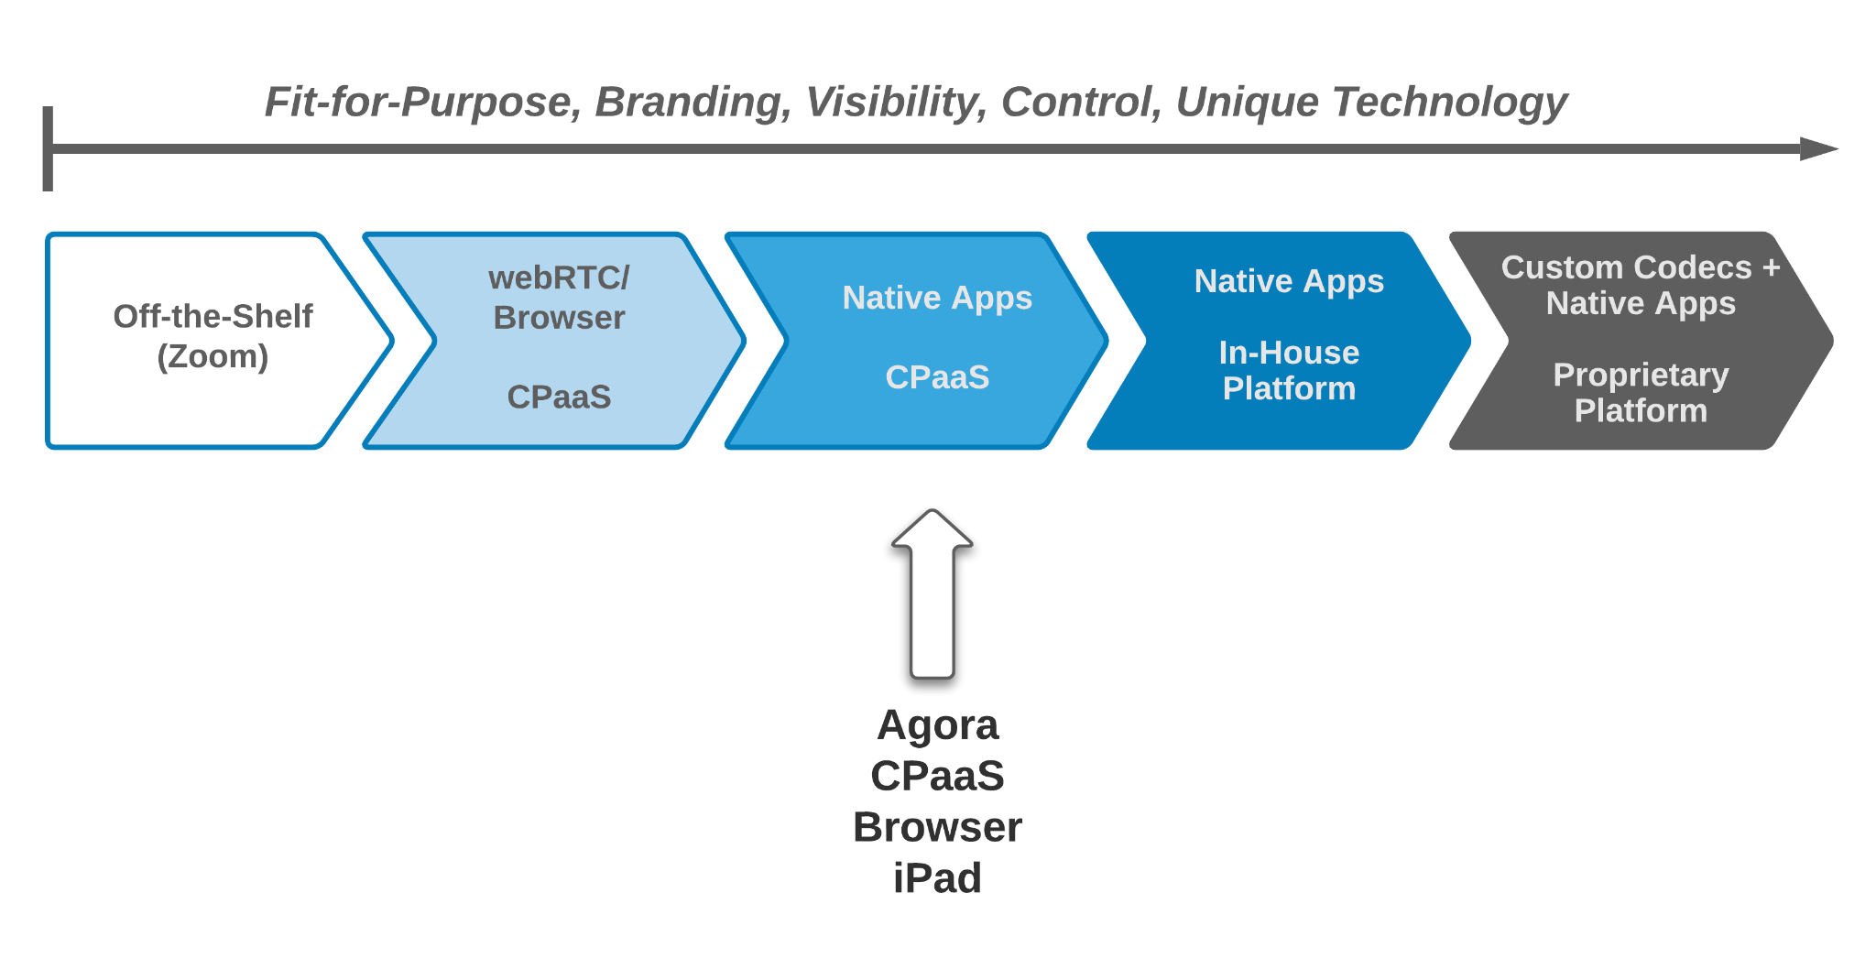
AV Roadmap
Next Step
All native apps for best control and use of vendor-specific options
IOS (participant only
Windows/MacOS: Common platform including Instructor
Evaluate where we are, and evaluate alternative to Agora (Twilio)
Hire Dedicated AV Engineer Cost (dev and test initial version):
Outside consultant 6 months: $100k
Use existing resources for test and API
Build and adoption: 7-9 months

Slide 4
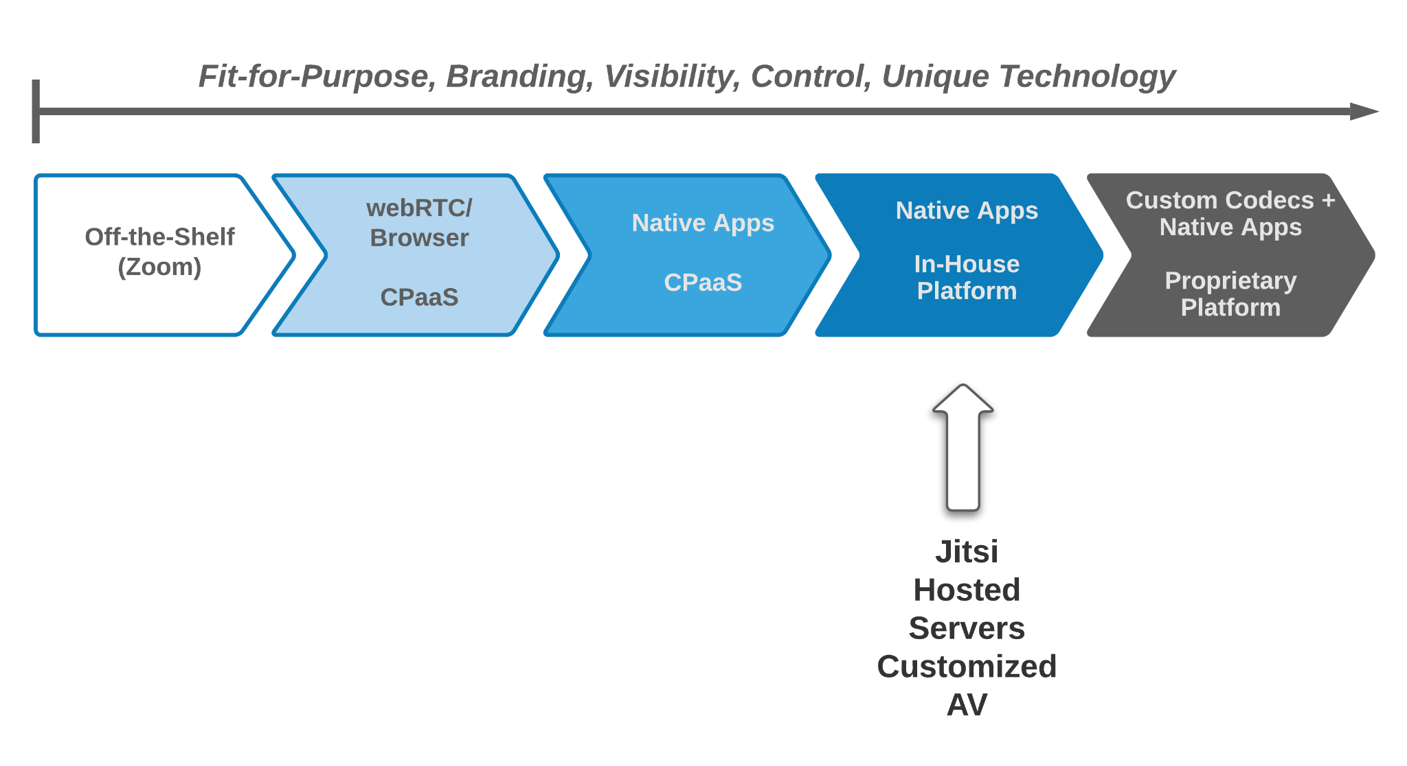
AV Roadmap
Self-Hosted
Host servers for even more custom control
Initial rollout plus additional operations and development support
Additional Staff (initial and ongoing development):
1 DevOPS
1 Server-side platform engineer
1 AV (UI + server, desktop)
1 IOS/mobile
Build and adoption: 9-12 months

